Slide 1

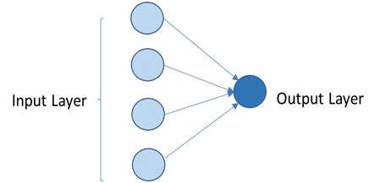
Single Layer ANN
Consists of Input and Output layer only
Can be trained to give better Output
Use for Simple problems only
R, C/C++, python, can be used for implementing Single Layer ANN
8

Slide 2
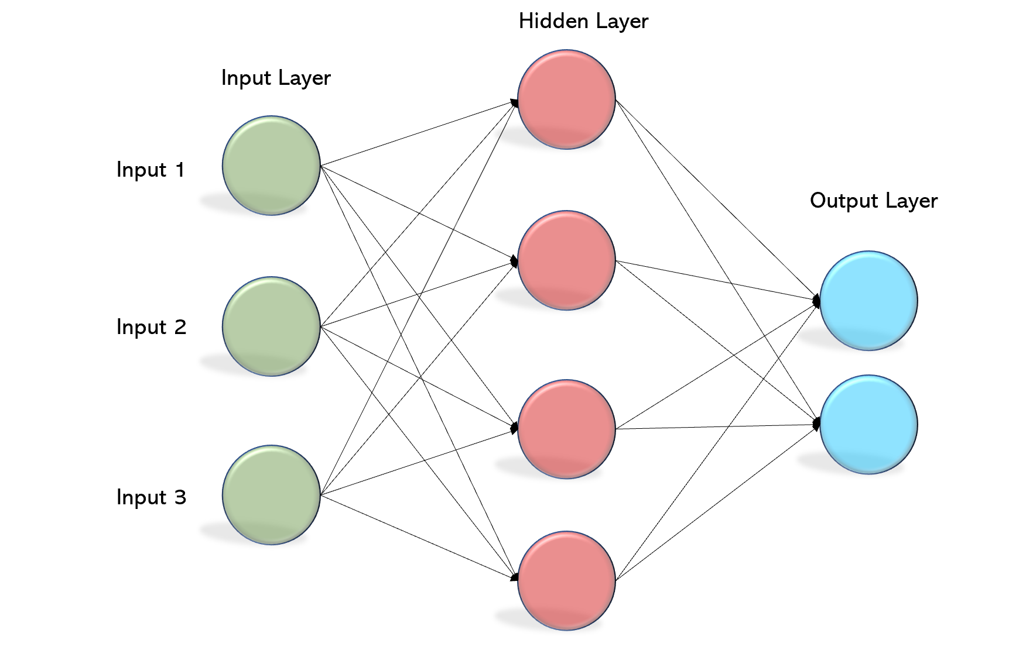
Multi Layer ANN
Consists of Input layer ,hidden layer and Output layer
Use for Complex problem
Use for image recognition, natural language processing , speech recognition, etc
R, Java, python, C/C++, etc are used for implementing Multi Layer ANN
9

Slide 3

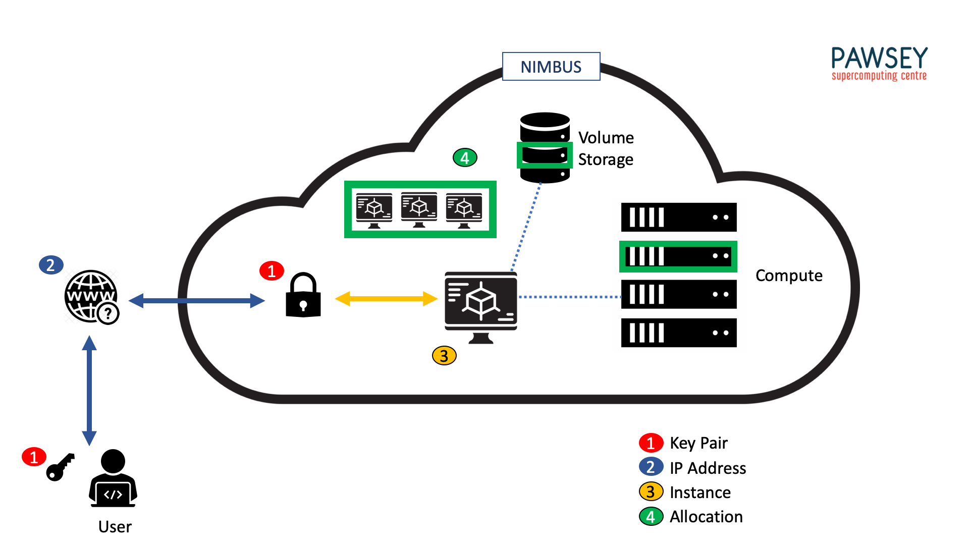
Nimbus
Open source software
Customizable and flexible
Provides Infrastructure services for researcher and scientist
Very useful for Researchers who needs on demand computing service

Slide 4
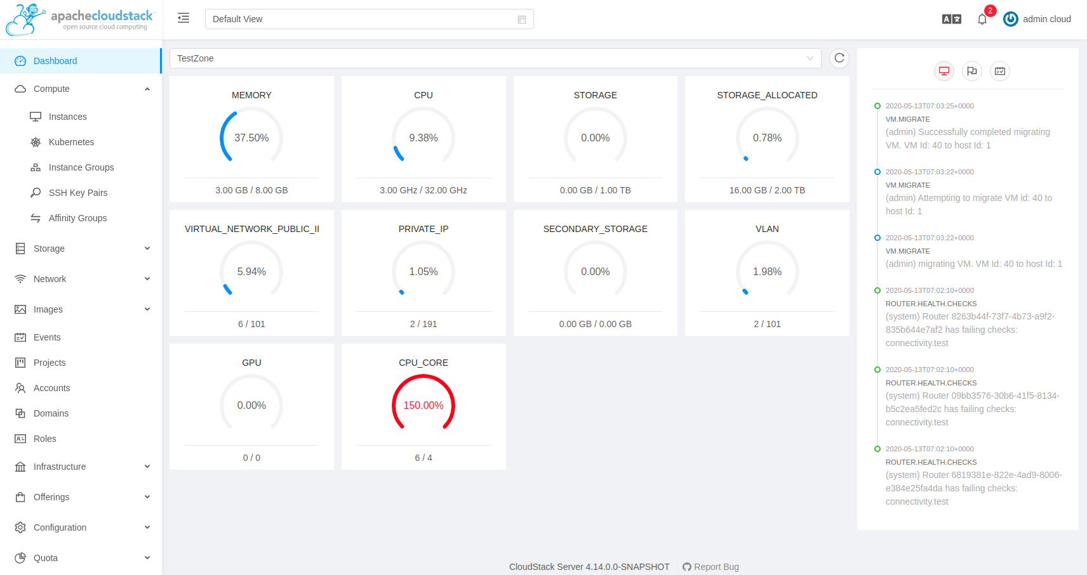
Apache Cloud Stack
Open Source cloud computing platform
Developed by Cloud.com and later acquired by Citrix
Powerful tool for building and managing the cloud
Can be used from different geographical location

